Slide 1

Senior design project muvtime
Advisor:
Associate Professor Tuğba ÖNAL SÜZEK
Muğla Sıtkı Koçman University
Department of Computer Engineering
Erkin Alkan
Muğla Sıtkı Koçman University
Department of Computer Engineering
Advisors: Dr. Tuğba ÖNAL SÜZEK
Muğla Sıtkı Koçman University
Department of Computer Engineering

Slide 2


MuvTime is a comprehensive fitness application that combines AI-powered pose detection with gamified exercise tracking. Users can perform various exercises while the app uses computer vision to count repetitions, track progress, and award with experience points.
Technologies
Java
C# with .Net
Yolov8 model processed with python to a ONNX file
Database Supabase (PostgreSQL)
Hosting: Azure App Service (Backend Deployed)

Slide 3
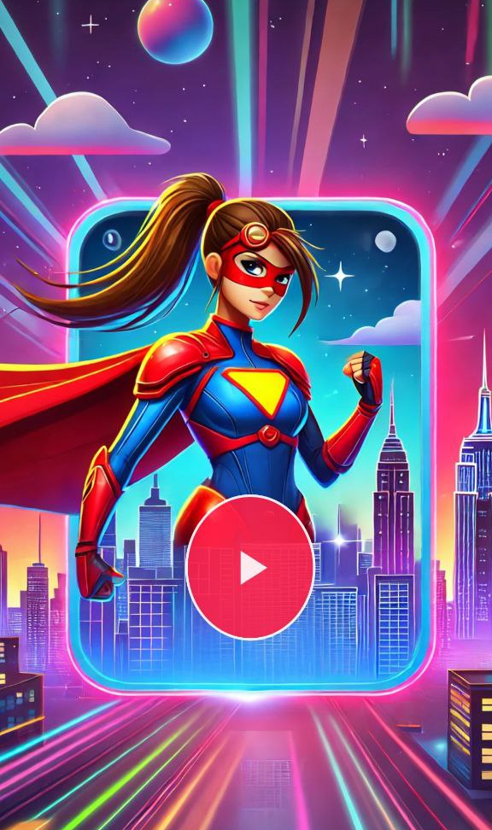
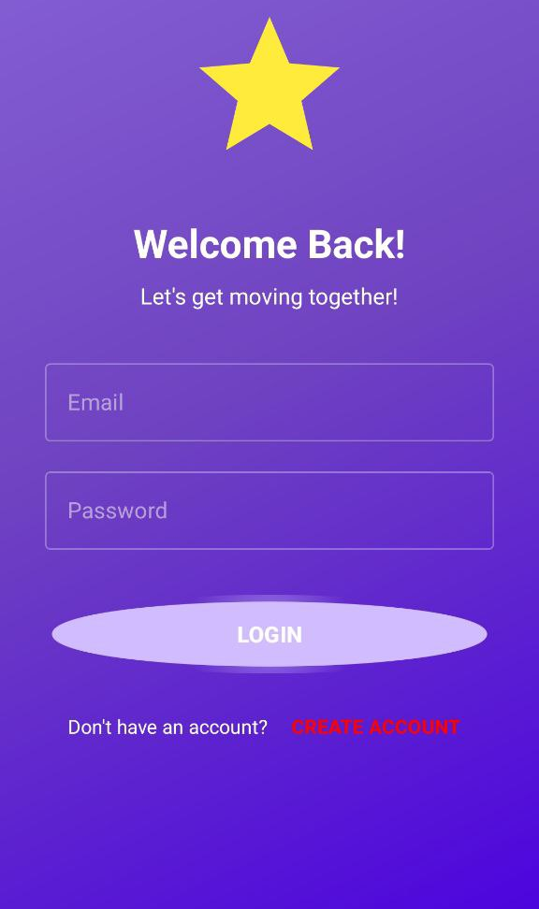
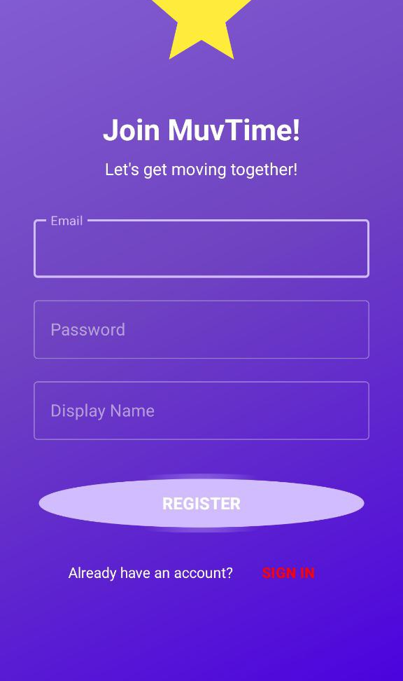

Slide 4
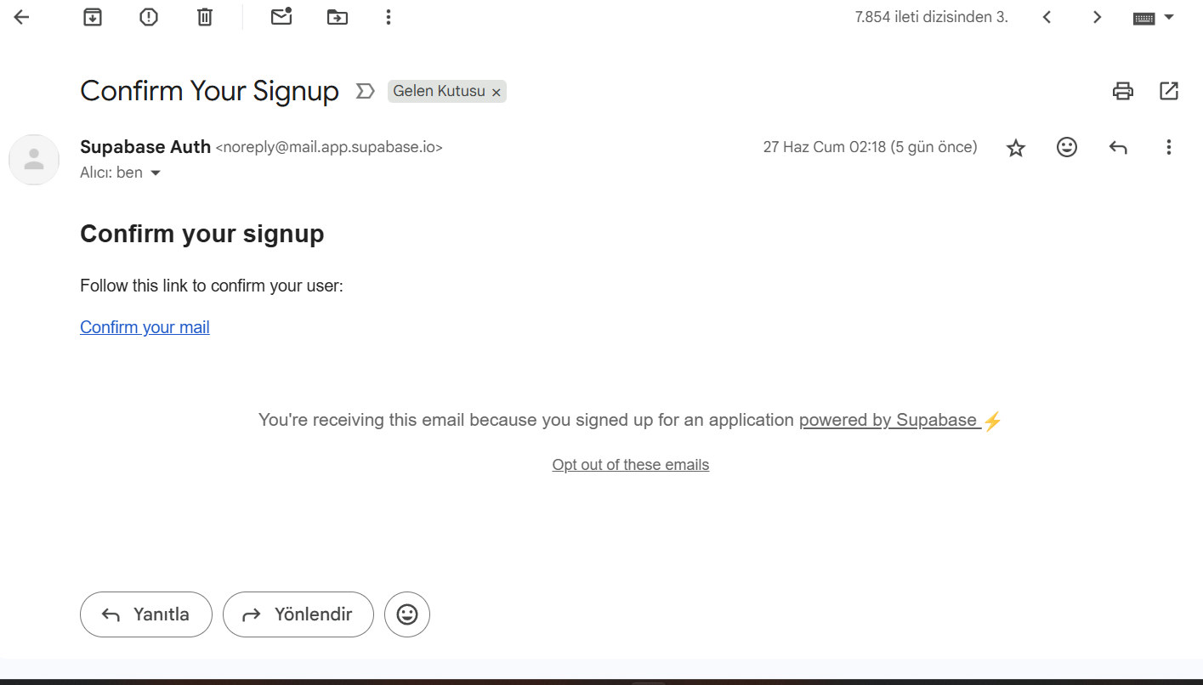

Slide 5
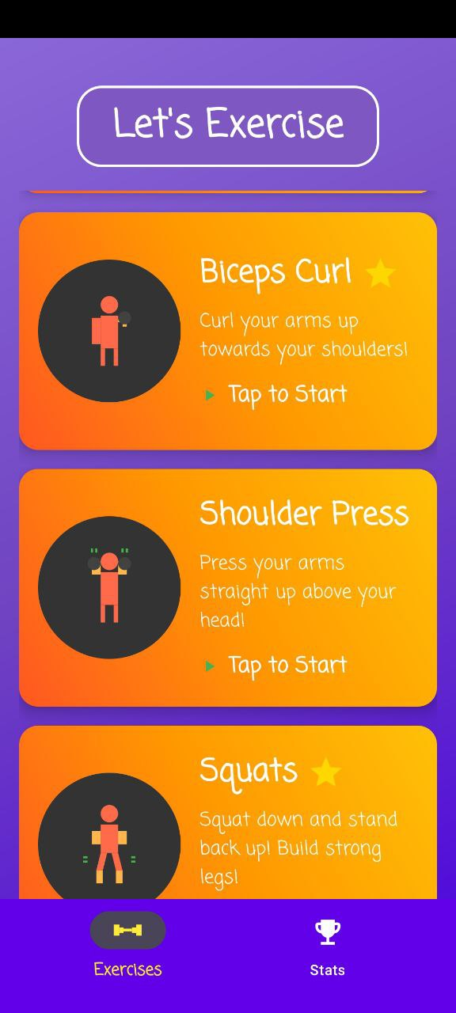
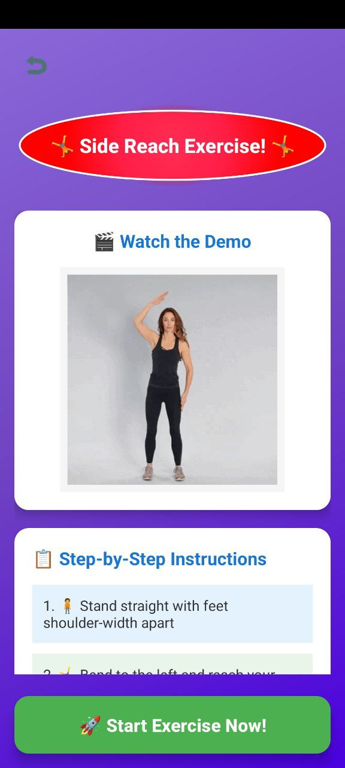
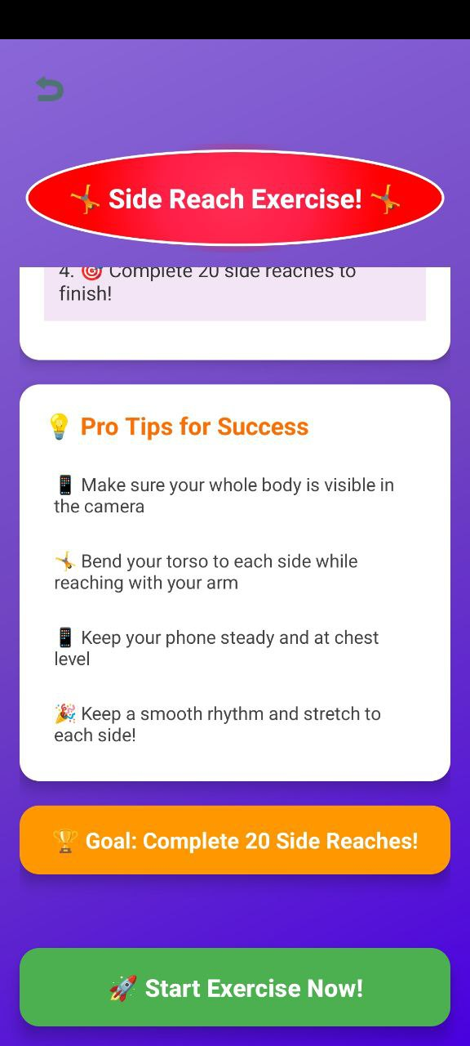

Slide 6
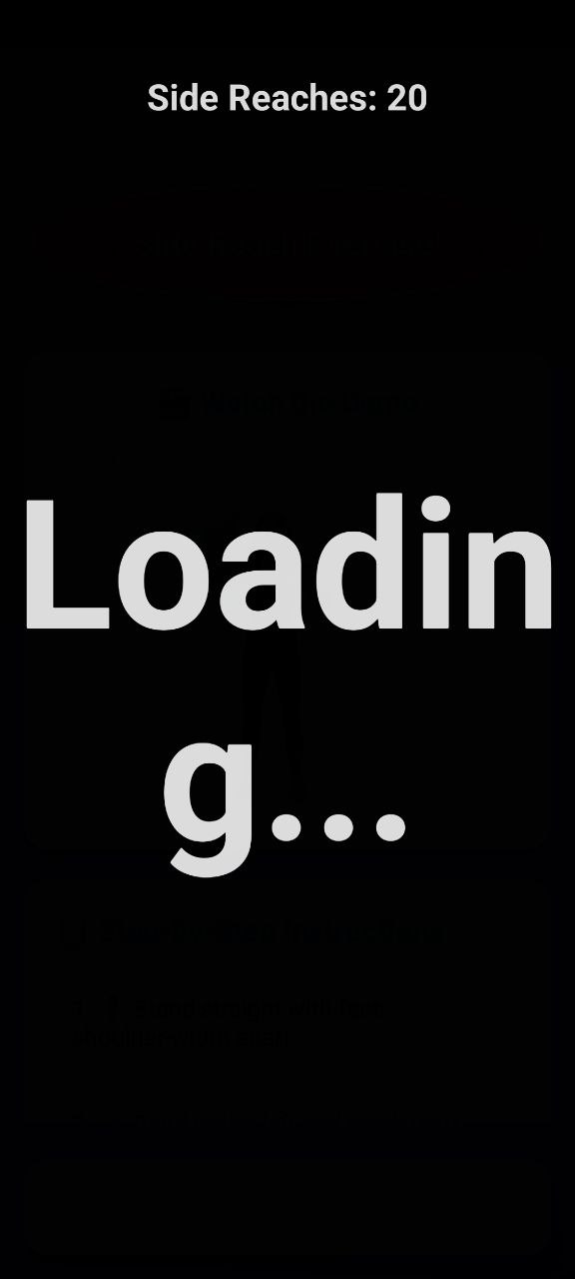
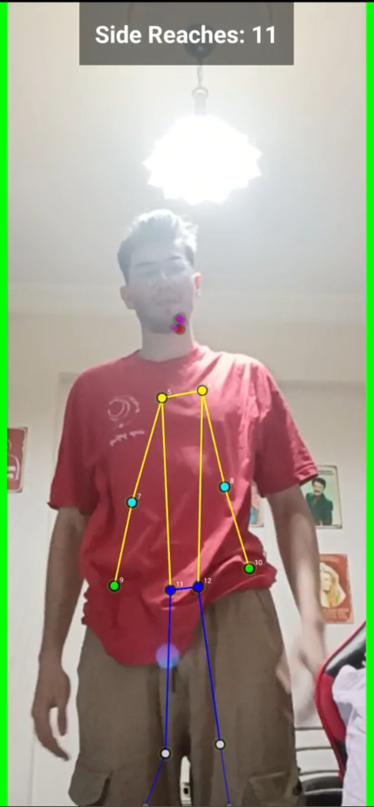
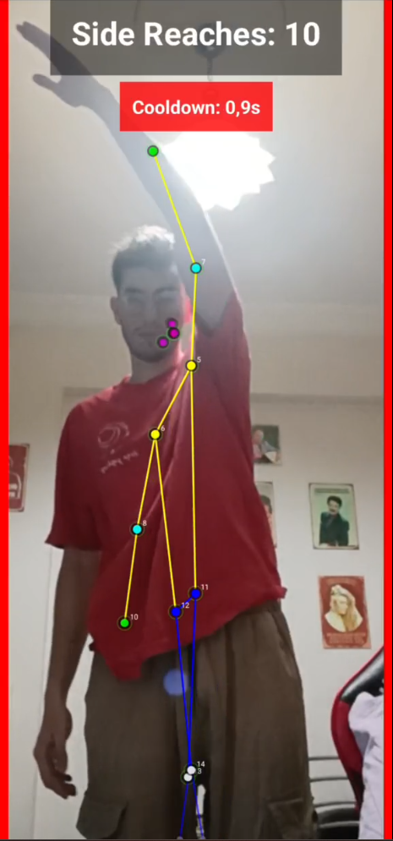

Slide 7
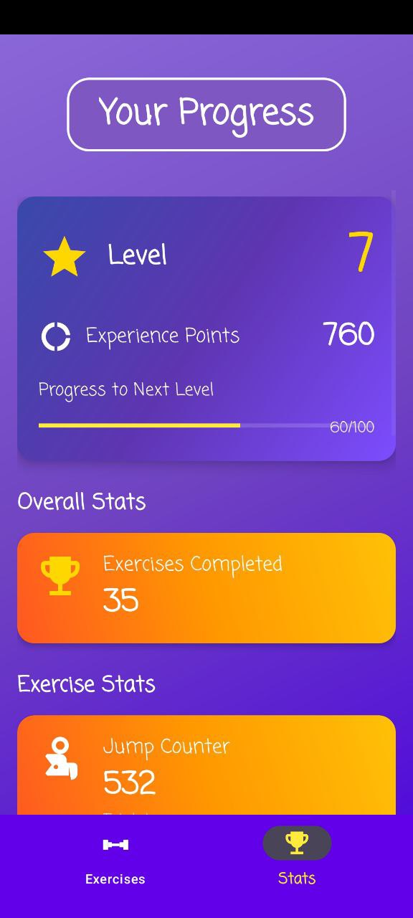
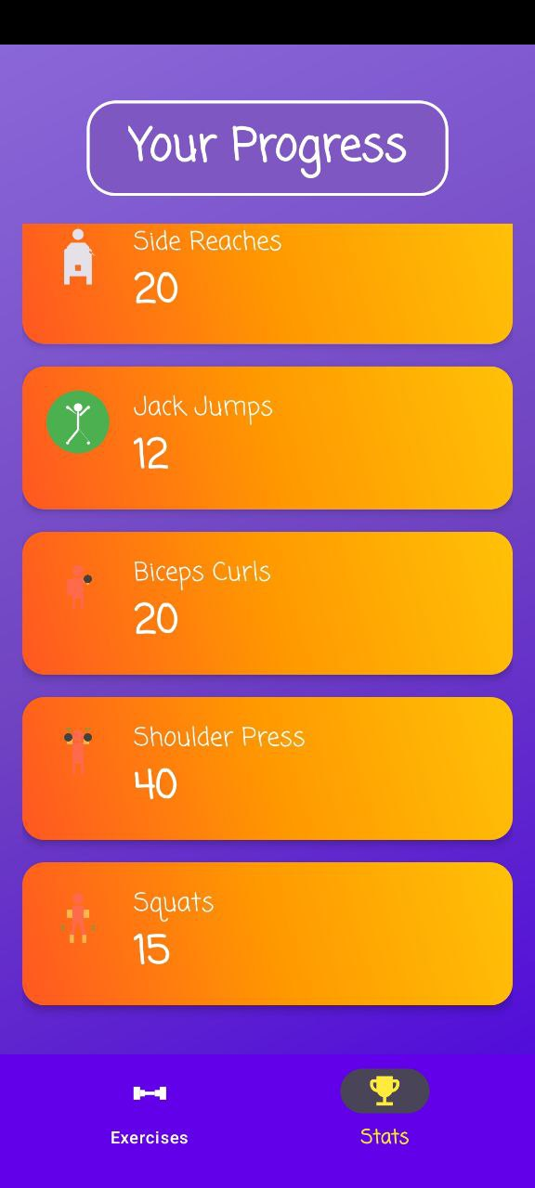

Slide 8
Completed
Applied to Tubitak 2209/A
Applied GBYF 2025
Frontend
Backend Deployed
Database Deployed
8 Exercises and their calculations
Login/Register and authentication with e-mail
150 mb storage (didn’t cross the 200 mb limit I gave myself)
Released first apk to github!

Slide 9
Future works:
Brand new exercises
New authentications (Phone,facebook,Instagram)
Leaderboard system
Friend System
Sounds
UI enhancements

Slide 10
THANK YOU! :d email: erkinalkan2002@gmail.com GITHUB: https://github.com/erkinal/finalprojecttest APK LINK: https://drive.google.com/file/d/1mc1o5yvodsyp28lx5031tlw3txrcq5ll/view

